Slide 1
Health Status Indicators

Slide 2
Problem Statement & Introduction
Behavioral Factors:
Understand health status indicators such as obesity, tobacco use, diet, physical activity, drugs, alcohol usage and others.
Understand how they contribute and relate to leading causes of death like heart disease, cancer etc. and determine what affects them at the county level.
Predictive Modeling:
Predicting Leading causes of death - Lung Cancer, Breast Cancer, Colon Cancer, Poverty, Heart Diseases etc.
Exploratory Data Analysis
Focused Analysis : Illinois
Modelling
Leading Causes of Death
Segmentation of Counties based on Leading Causes of Death
Problem Statement & Introduction

Slide 3
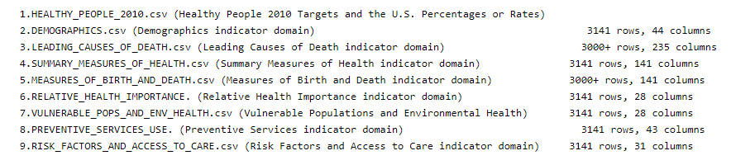
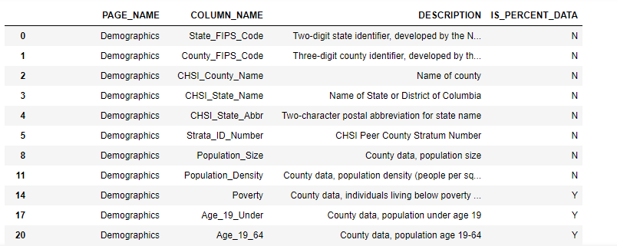
Project Pipeline at a Glance
Problem Statement & Introduction
Data Cleaning
Data Dictionary
Data Exploration
Modelling & Prediction
Data
Data Dictionary

Slide 4
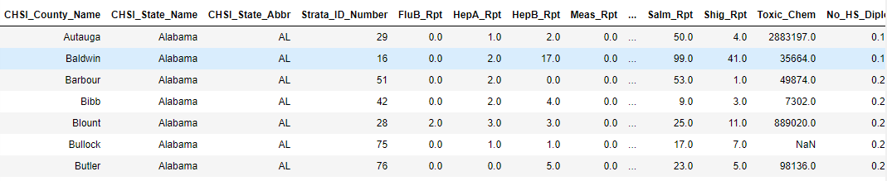
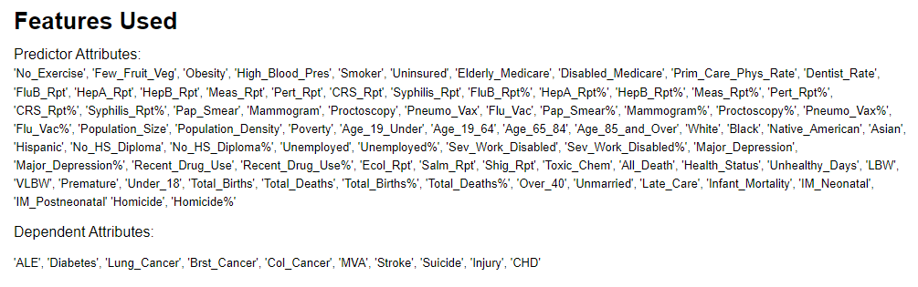
Prepared Data
Problem Statement & Introduction
Each record of the data frame represents a county of United States and corresponding values of health status indicators like Flu%, No High School Diploma%, Population Density, Obesity etc.

Slide 5
Data Exploration
Exploratory Data Analysis
Focused Analysis : Illinois
Modelling
Leading Causes of Death
Segmentation of Counties based on Leading Causes of Death
Problem Statement & Introduction

Slide 6
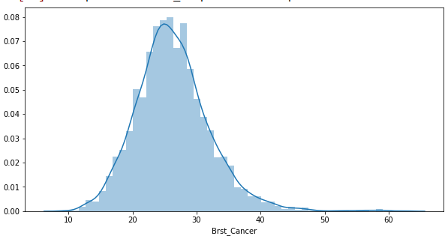
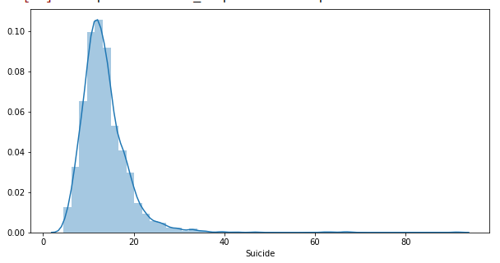
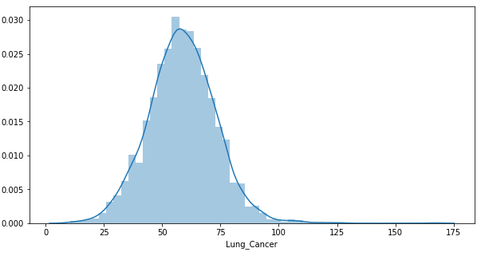
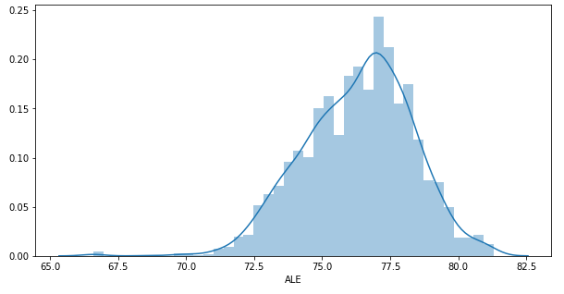
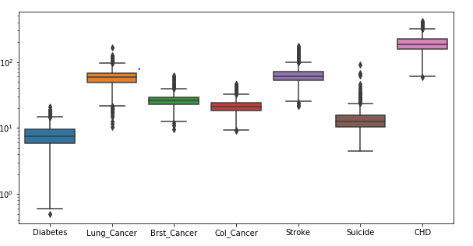
Exploratory Data Analysis
Insights - 1 : Leading Causes of Death
Boxplot
Notes:
Y axis is on the log scale in the boxplot
Diabetes Cases across counties vary a lot and have quite a few outliers
Almost all attributes follow a normal distribution as can be seen from the histograms
Average Life Expectancy has a mean value of 77.5, however few counties have even less than 70 years of average life expectancy.

Slide 7
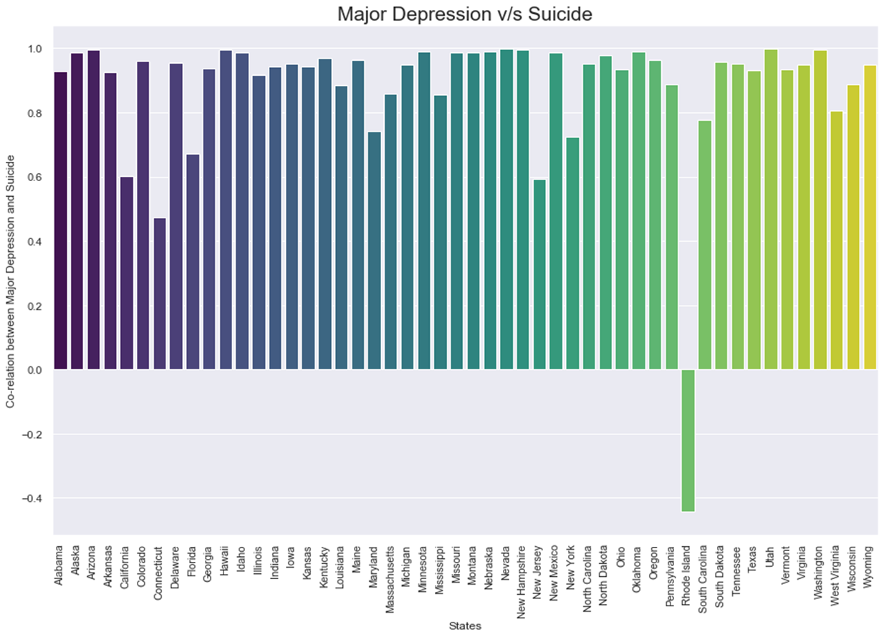
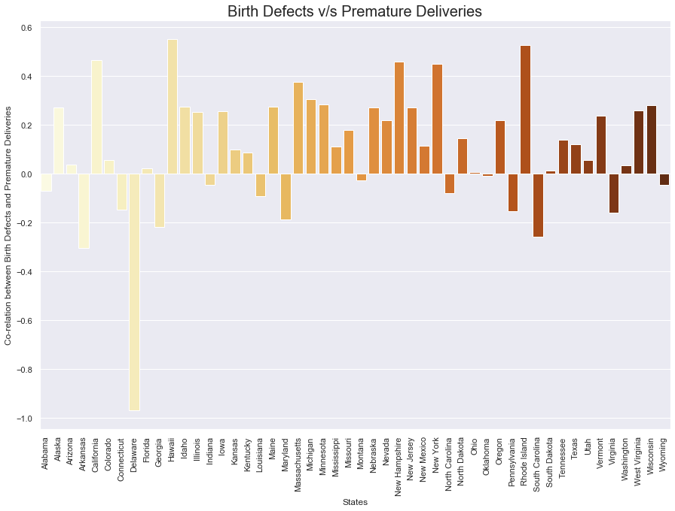
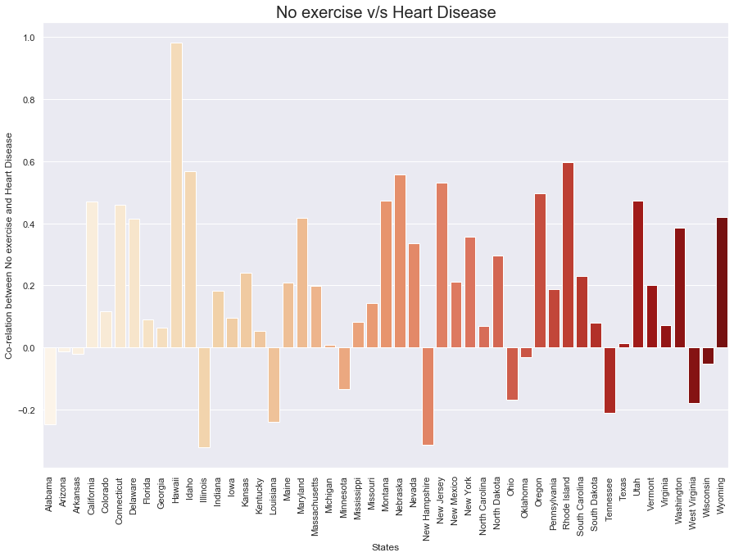
Exploratory Data Analysis
Insights - 2 : Correlation
1. Correlation between Major Depression and Suicide : As we can see in the graph there is a strong positive co-relation between Major Depression and Suicide in all the states of the USA except in Rhode Island.
2. Correlation between Birth Defects and Premature Deliveries: There is a positive co-relation between birth defects and premature deliveries in around 21 states of the USA. So, it can be considered that the premature deliveries might be one of the causes for people dying due to birth defects.
3. Correlation between No exercise and Heart Disease : There is a positive co-relation between No exercise and Heart Disease in most of the states of the USA.

Slide 8
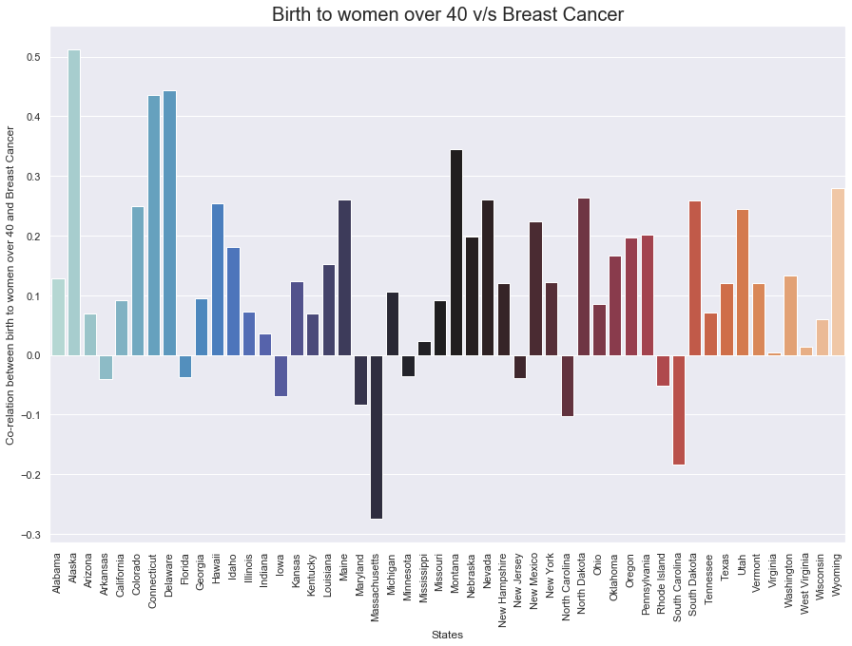
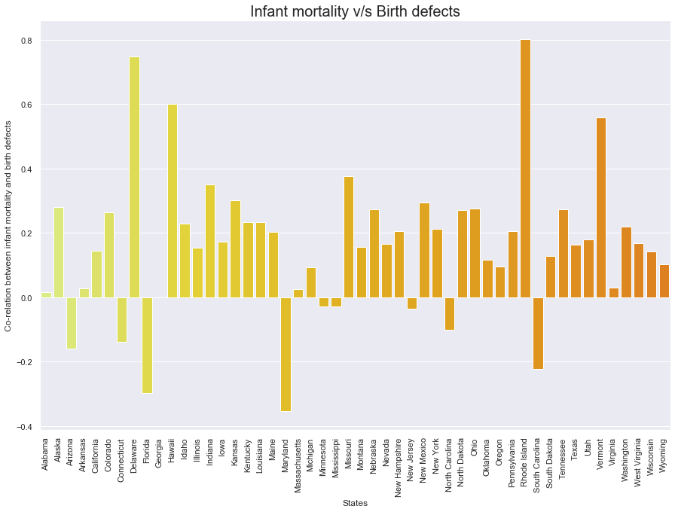
Exploratory Data Analysis
Insights - 3 :
4. Correlation between Birth to women over 40 and Breast Cancer : There is a positive co-relation between birth to women over 40 and breast cancer in around 15 states in the USA.
5. Correlation between Infant Mortality and Birth Defects : There is a positive co-relation between infant mortality and birth defects in around 22 states as shown in the visualization.

Slide 9
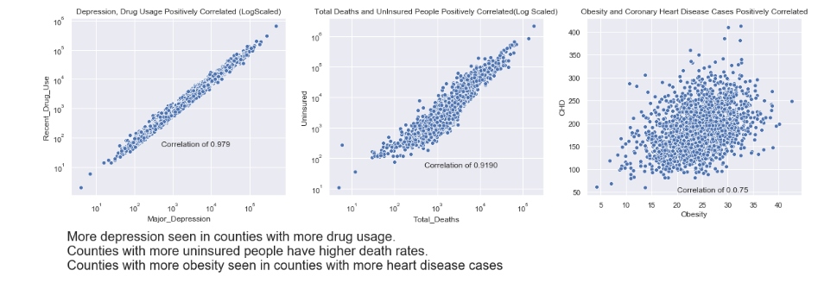




Exploratory Data Analysis
Insights – 4

Slide 10


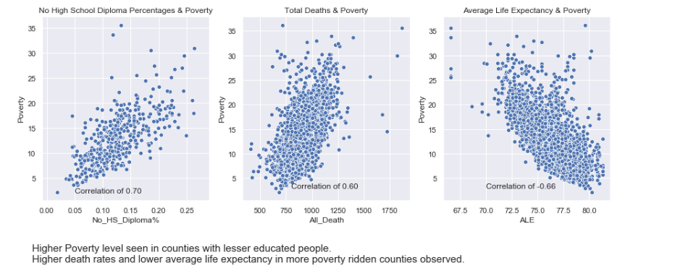
Insights – 5
Exploratory Data Analysis

Slide 11

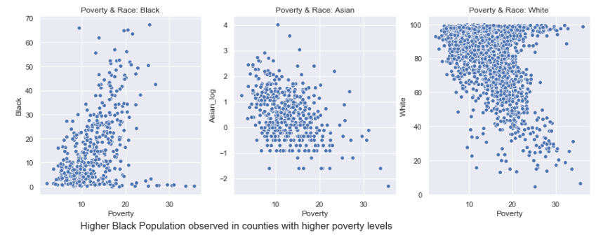
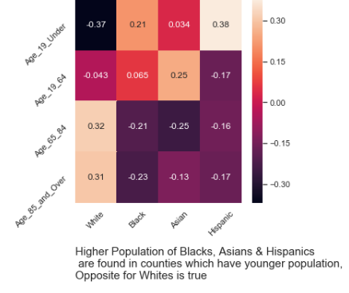
Insights – 6
Exploratory Data Analysis

Slide 12
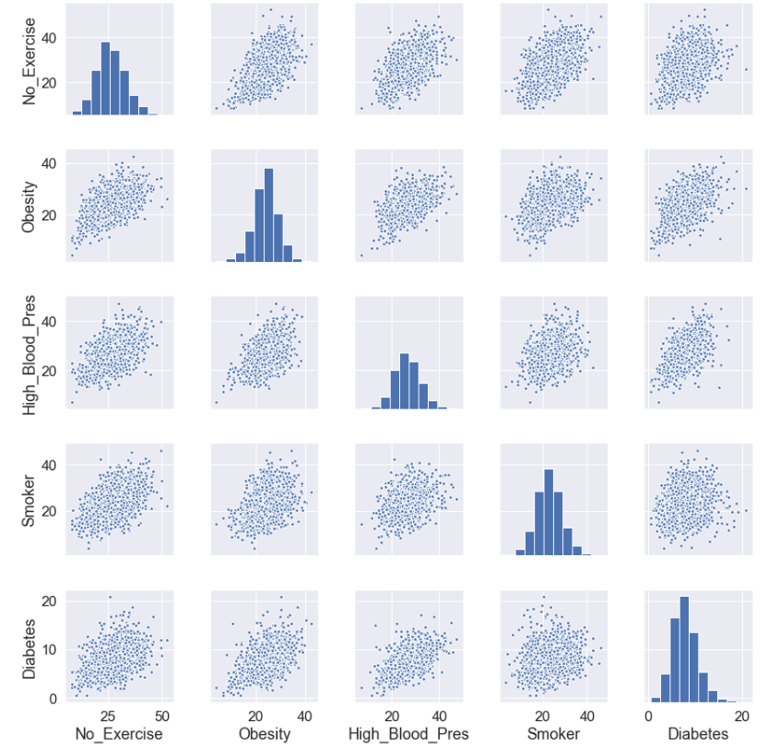

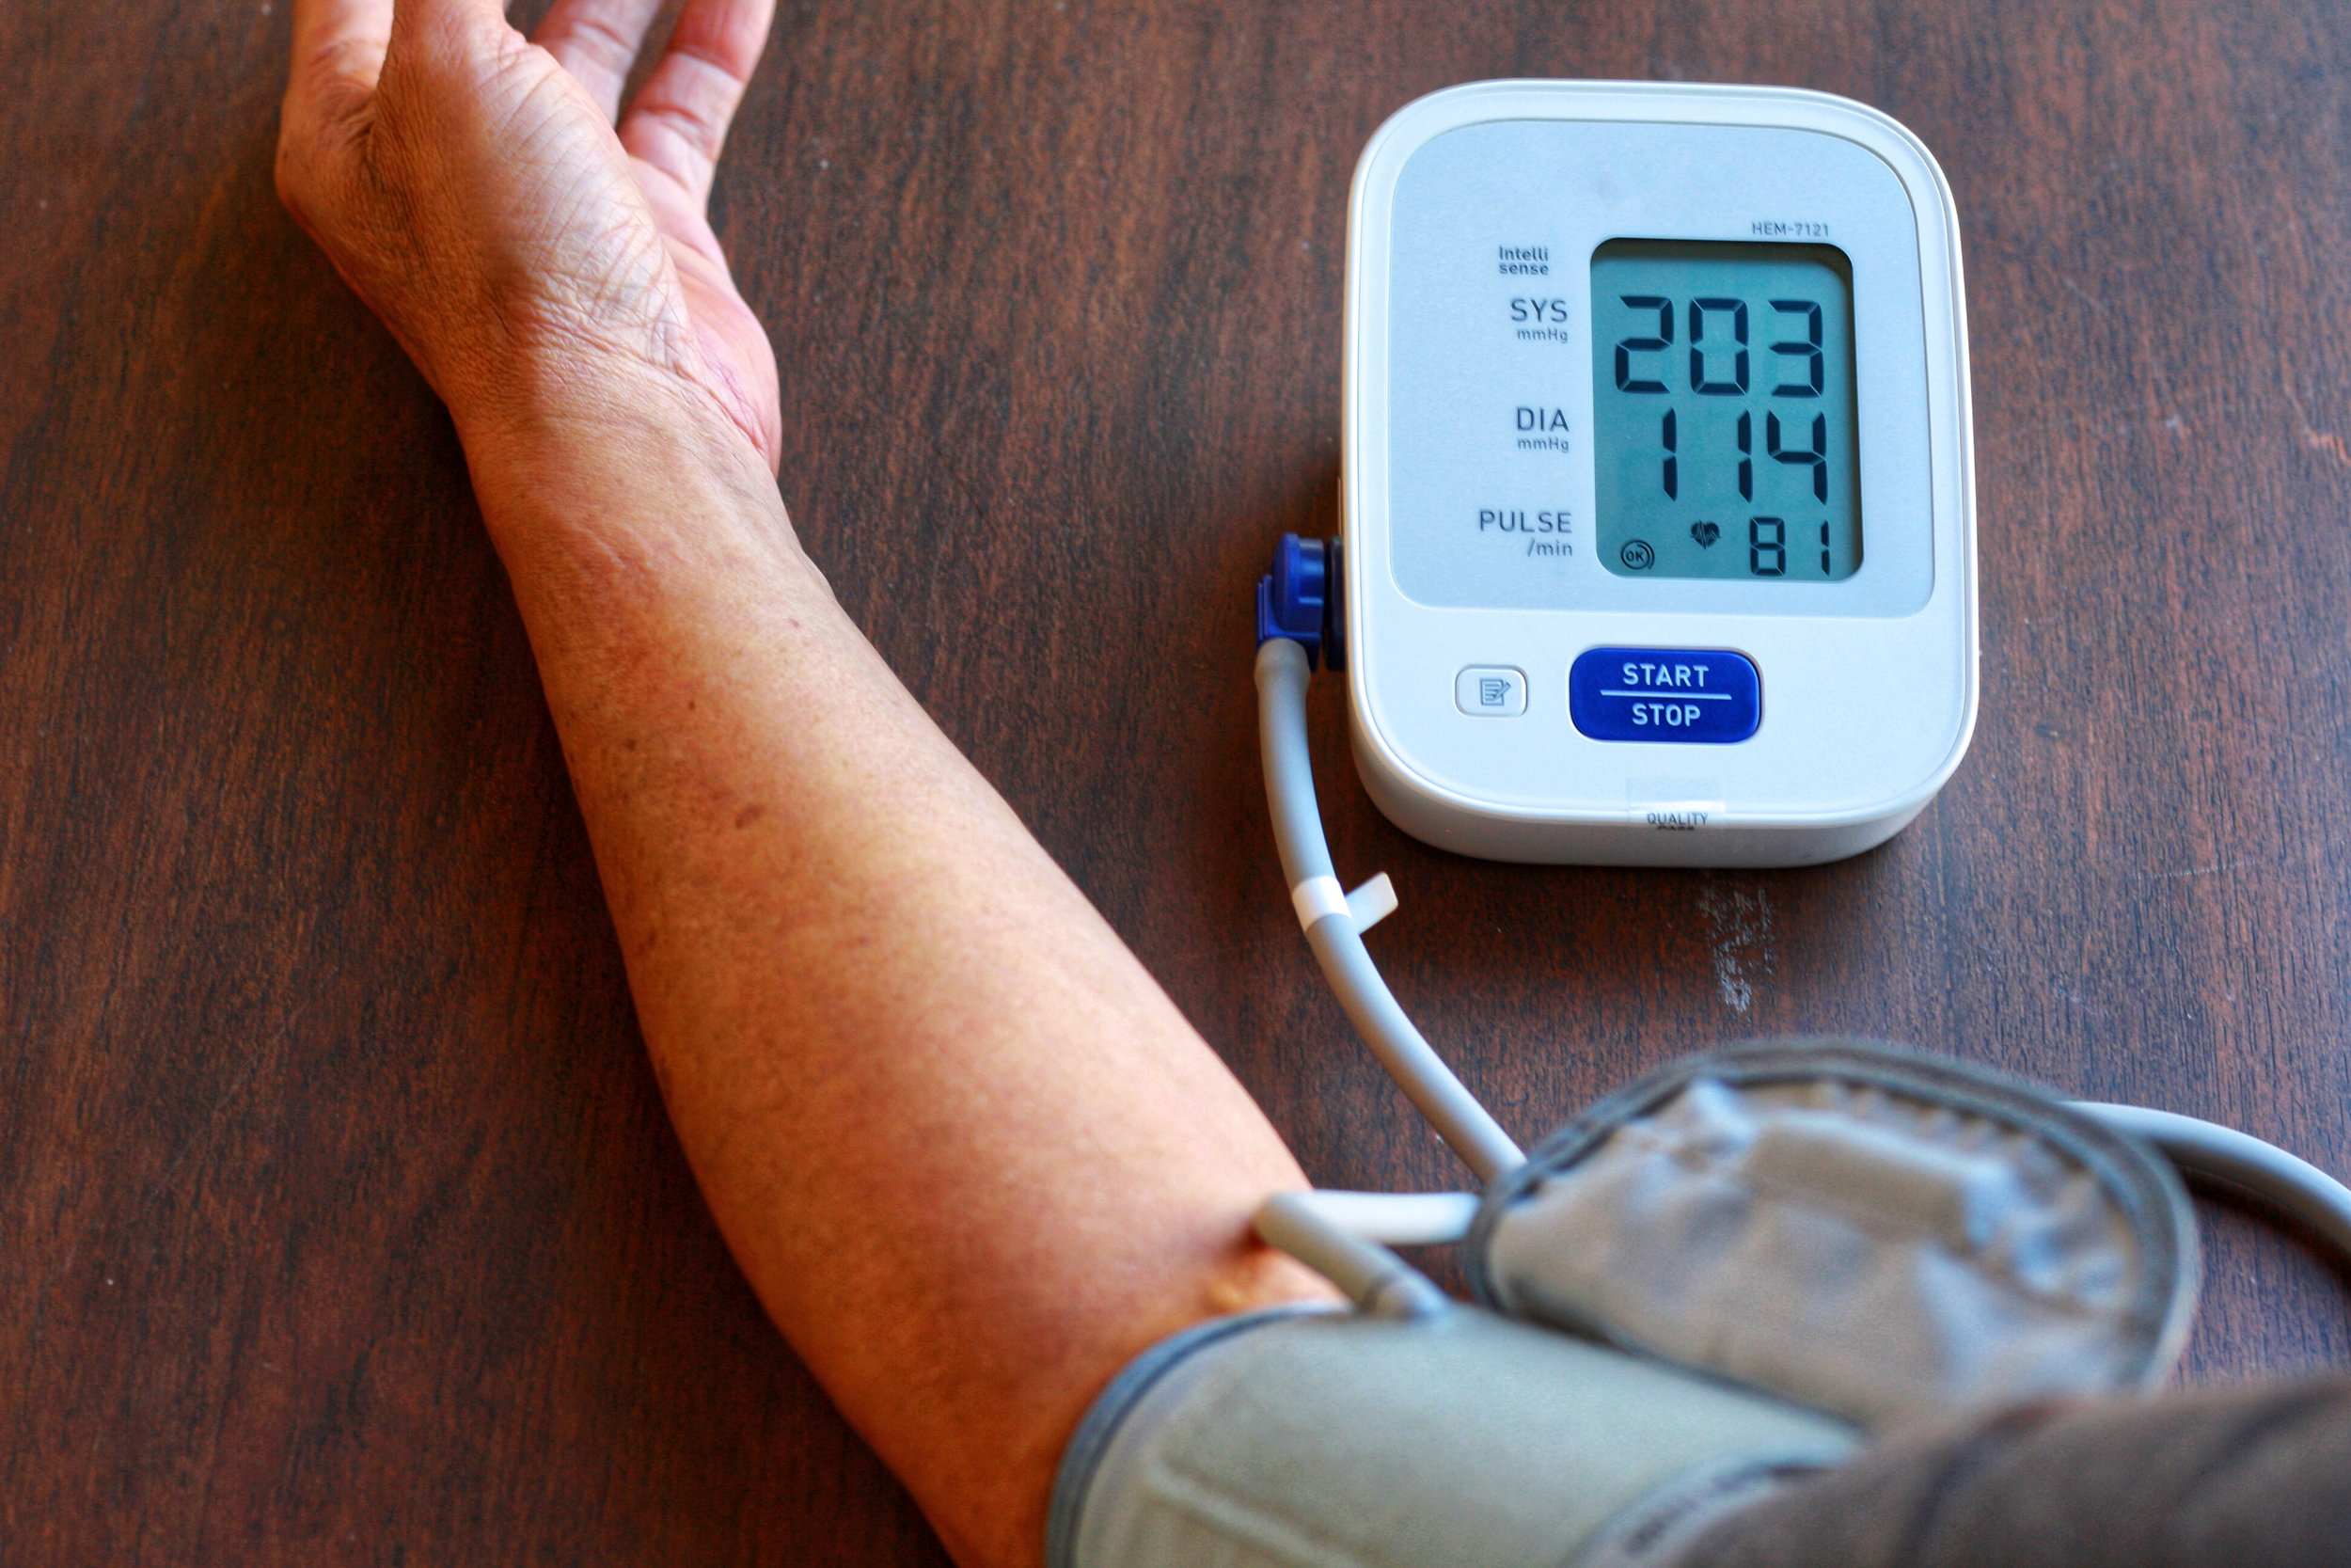


Insights – 7
Exploratory Data Analysis

Slide 13
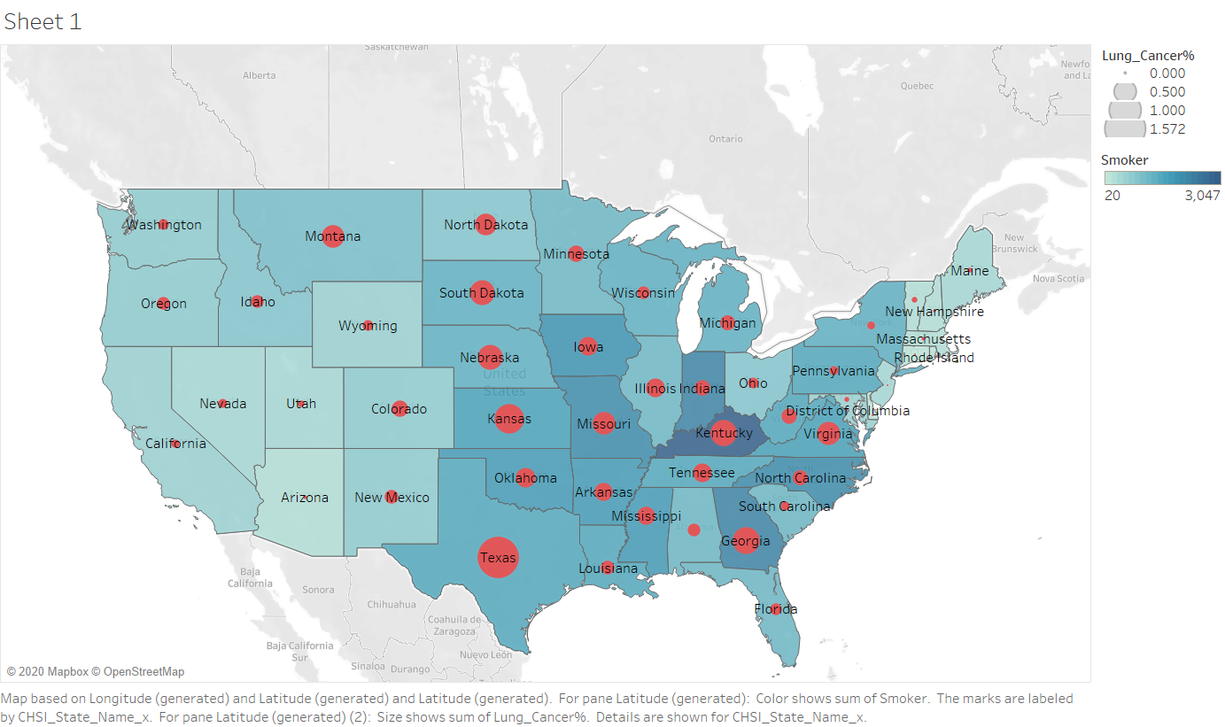
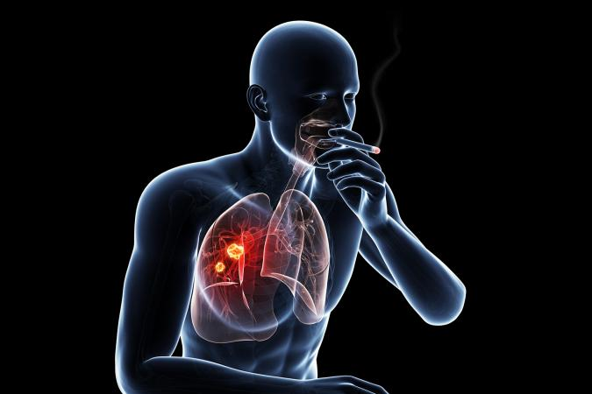
Exploratory Data Analysis
Insights – 8
Lung Cancer & Smoking

Slide 14
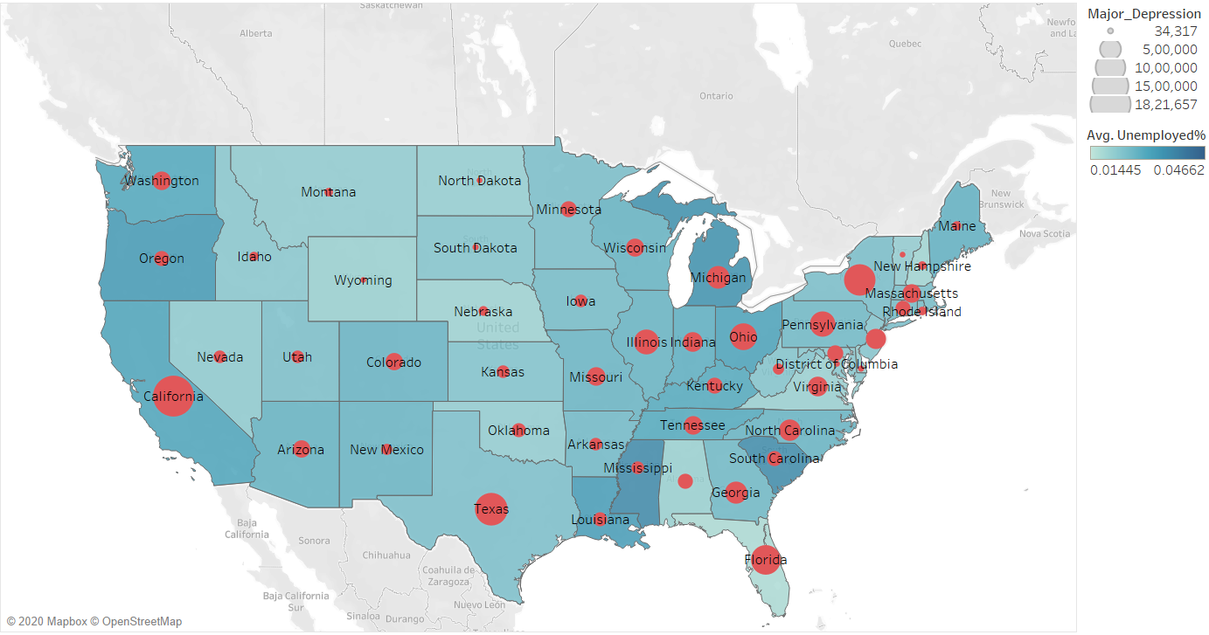

Insights – 9
Exploratory Data Analysis
Depression & Unemployment

Slide 15
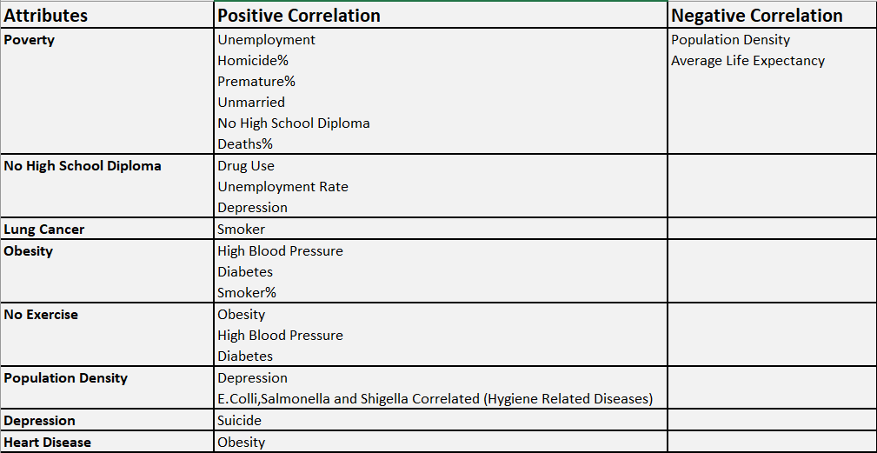
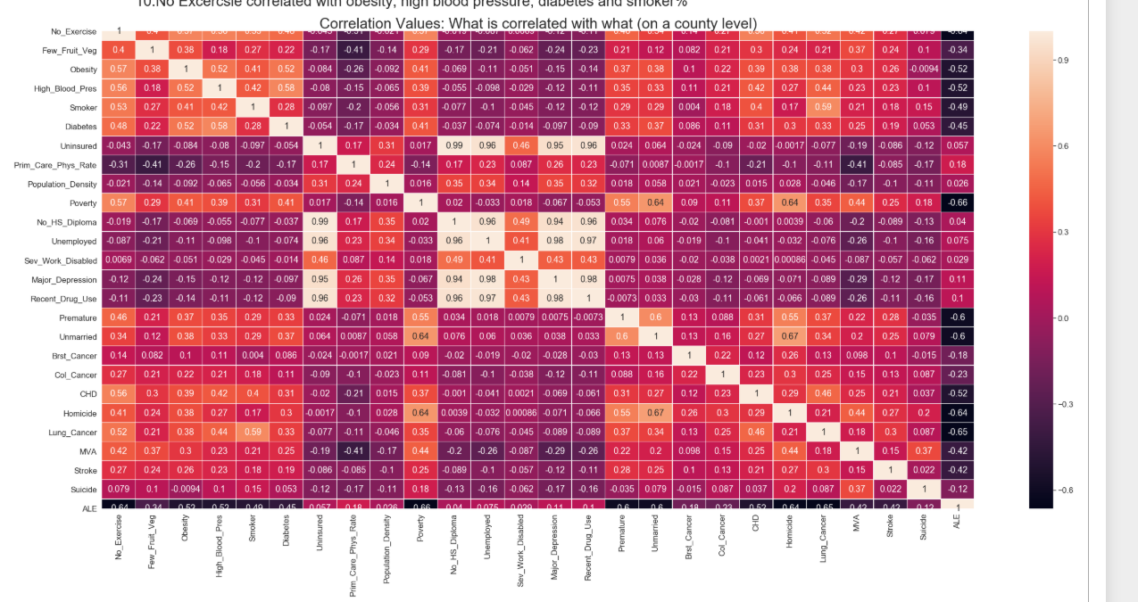


Exploratory Data Analysis
Insights – 10

Slide 16
Illinois County Data
Exploratory Data Analysis
Focused Analysis : Illinois
Modelling
Leading Causes of Death
Segmentation of Counties based on Leading Causes of Death
Problem Statement & Introduction

Slide 17
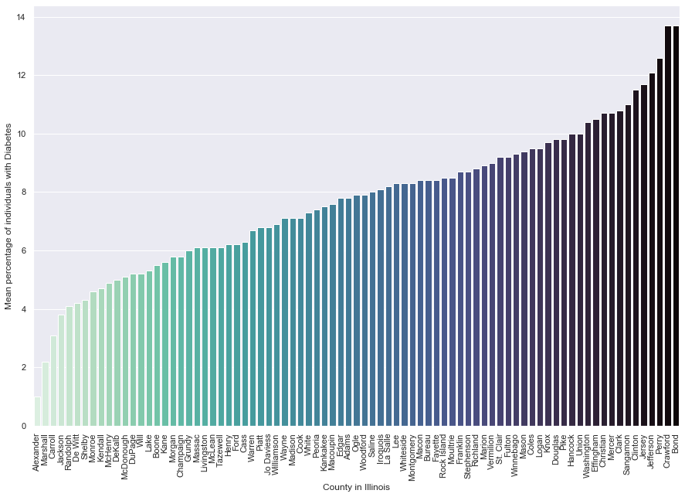
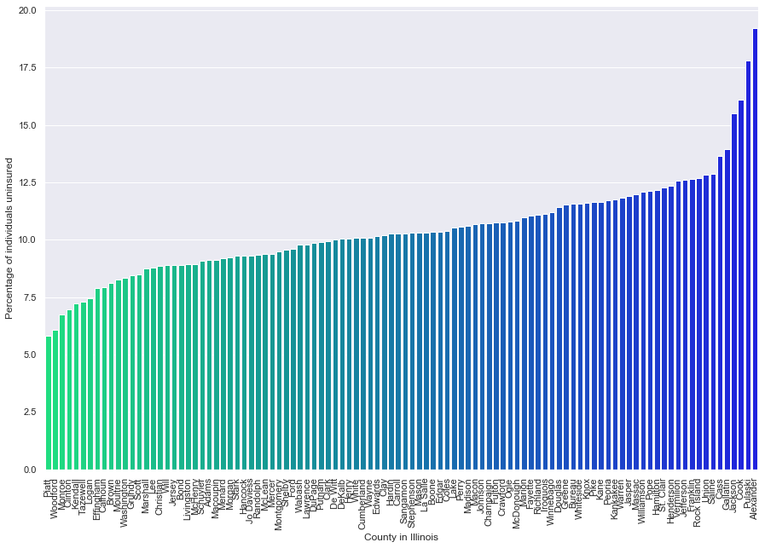
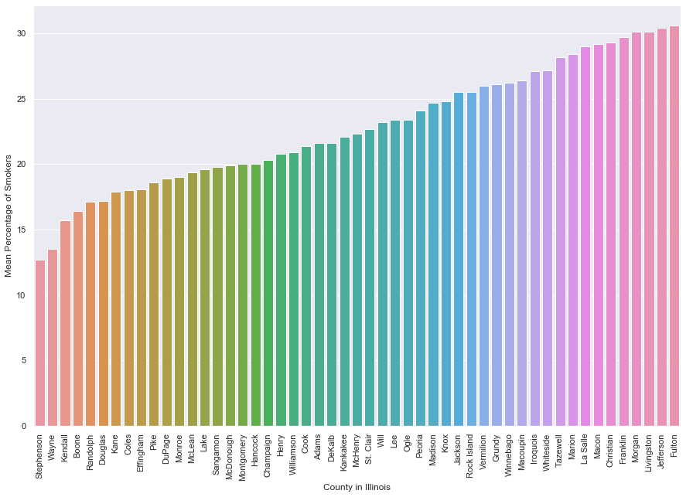
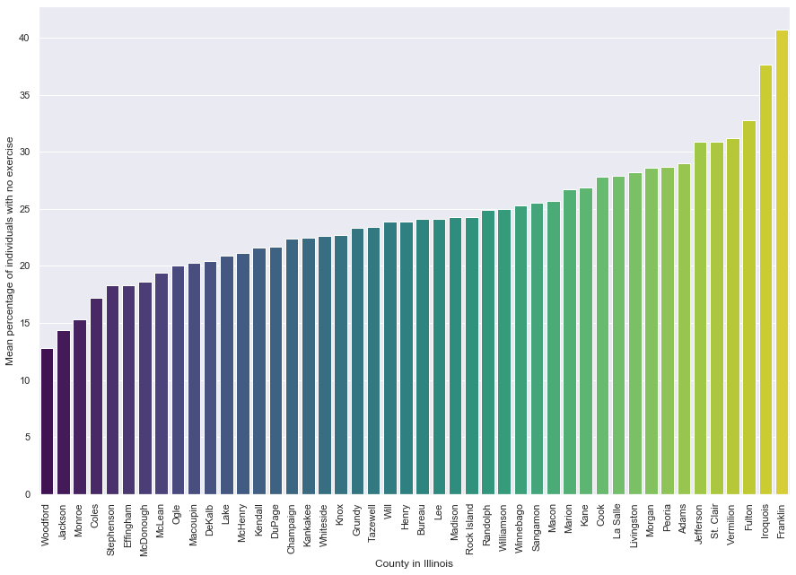
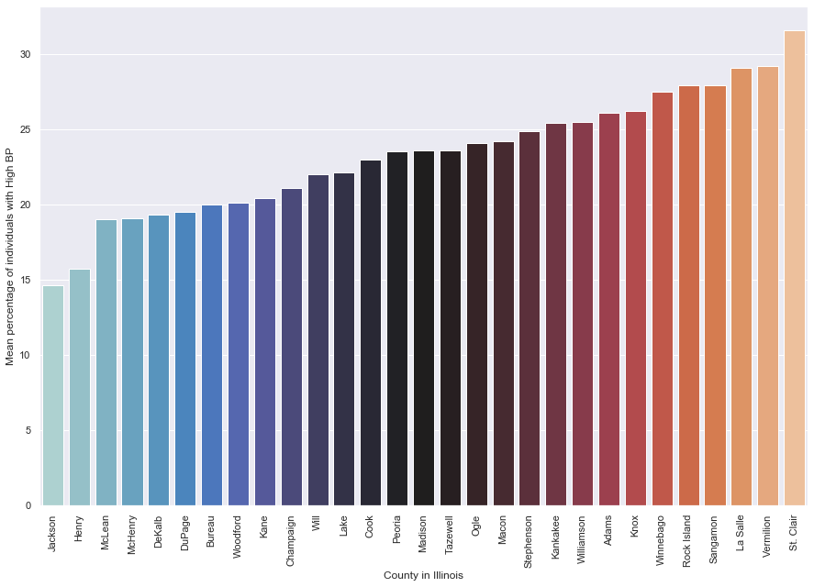
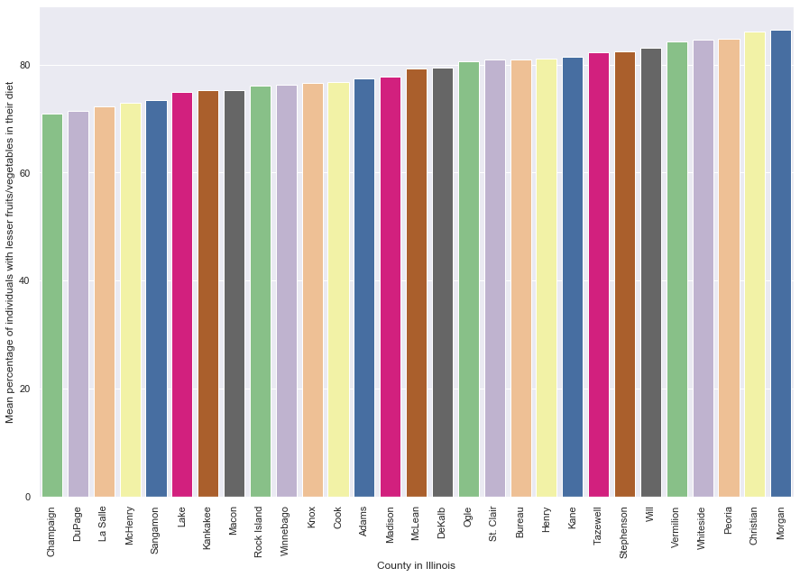
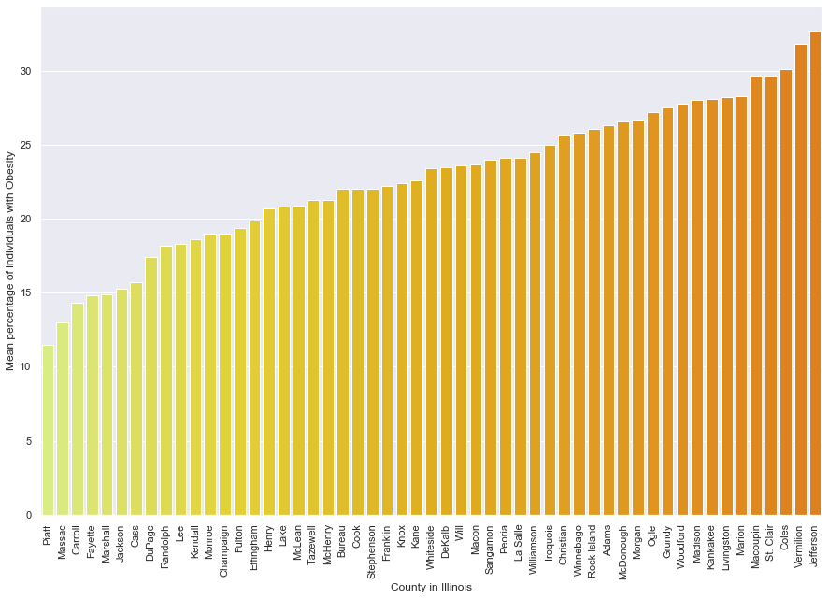
Illinois County Data

Slide 18
Main Takeaway from Illinois Data EDA
Focused Analysis : Illinois
According to the plots of smokers, unhealthy diets, no exercise, diabetes, high BP etc sorted by increasing order; Counties like Jackson and Du Page appear have healthier habits among the population while counties like Jefferson and Morgan lie on the unhealthier side of almost every chart with higher number of individuals indulging in poor habits. Cook, Knox and Madison appear to lie on the middle range.
As expected, the counties with fewer physicians per 100k population appear to have more uninsured individuals in that County with 2 outliers, Jackson and Cook.
The number of healthcare staff per population in a County could reveal more about the health of the individuals and total deaths, which is why that was chosen as a factor for modelling an unsupervised clustering algorithm.
Another important aspect of a healthy population is to focus on lowering the infant mortality rate. A pipeline of ML models and optimization would be required to efficiently understand the indirect factors affecting it.

Slide 19
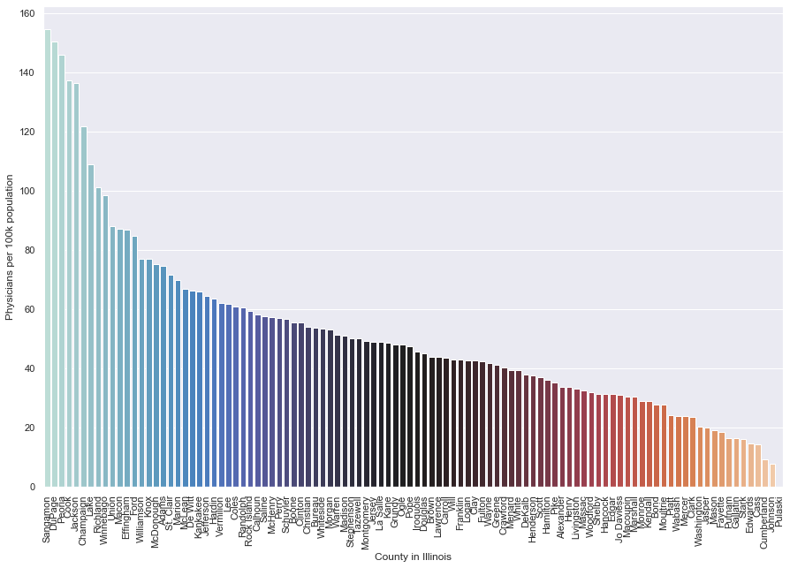
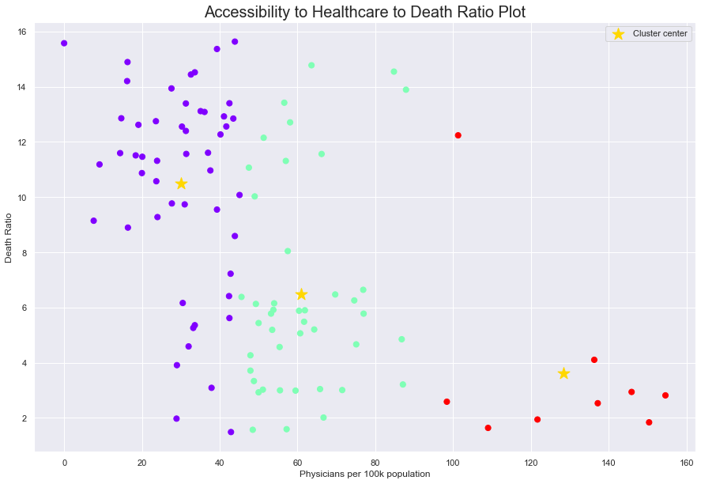
Unsupervised Clustering
Focused Analysis : Illinois
Taking the number of deaths from the Demographics data and comparing it to the number of physicians per 100k in the County data of Illinois, we arrive at the conclusion that the high death rate is due to lack of medical staff. Hence healthcare agencies need to focus on staffing the counties listed on the higher end of death rates.
The clustering algorithm has clustered the data with plenty of outliers, indicating that lack of medical staffing is not the only reason for a high or low death rate.
A robust ensemble model will be more accurate in predicting the leading factors affecting death rate.

Slide 20
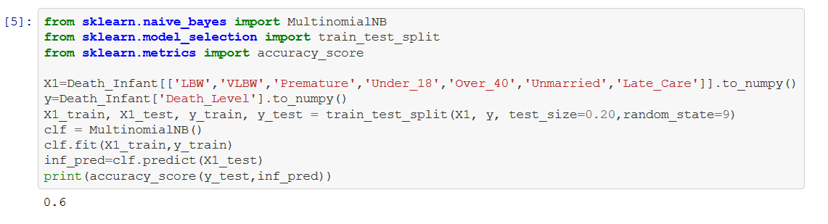
Infant Mortality Prediction
Focused Analysis : Illinois
The pipeline consists of 3 steps :
Clustering regions by low and high Infant mortality.
Running a Naïve Bayes Classifier to fit the data with features as shown to the Death Level and evaluating the model based on accuracy score given by the ratio of correct classifications.
Using Backward Elimination iterations to eliminate features with lesser influence to improve accuracy of classifications.
Initial accuracy with Illinois Data

Slide 21
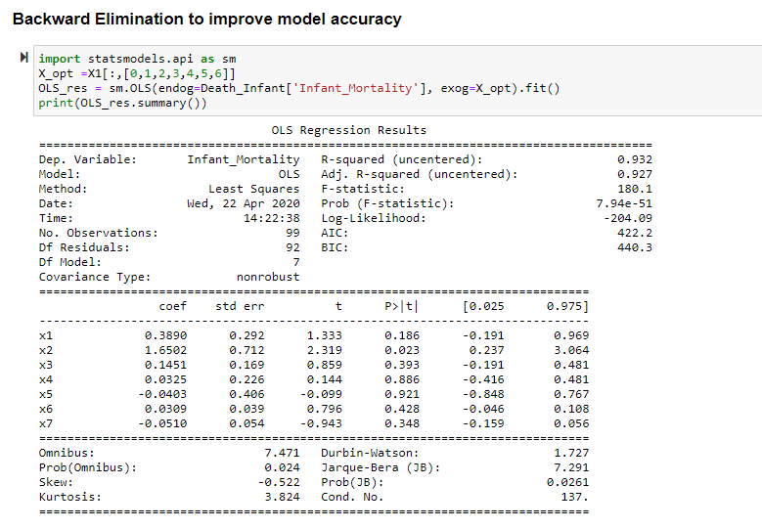
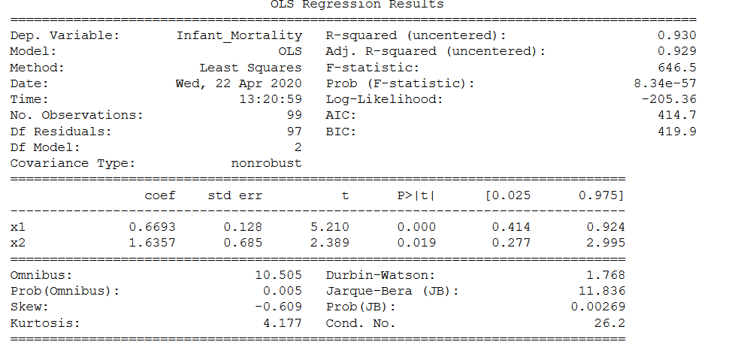
Focused Analysis : Illinois
The significance level is taken as 0.05. It appears that only the features Low Birth Weight and Very Low Birth Weight have an effect on the infant mortality for counties in Illinois after 5 iterations. This will change from State to State. Hence it is important to run this on different States to see which features have most impact which is a useful insight to healthcare agencies.
Low Birth Weight in turn could be a result of poor prenatal care for pregnant women or food insecurity amongst the population which results in malnutrition in mothers.

Slide 22
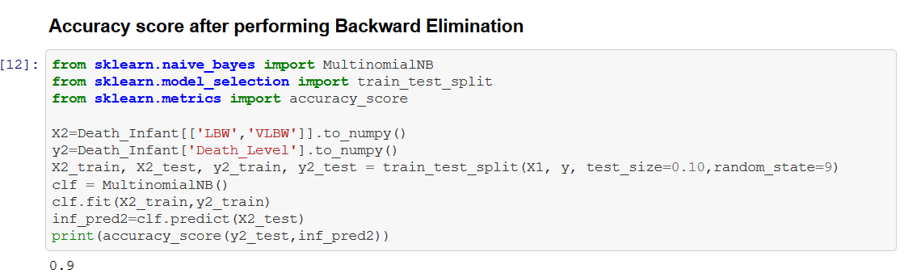
Focused Analysis : Illinois
The redundant features eliminated through backward elimination varies for each state.
Although, such a large increase in accuracy for this model is superficial. Since there is a high bias in this model, the accuracy can vary a great deal.
In order to make the model more robust, we require more data. But since unavailable data can’t be helped in this case (We cannot survey for more data) we will resort to making our predictions based on world data and with a different model such as random forest.

Slide 23
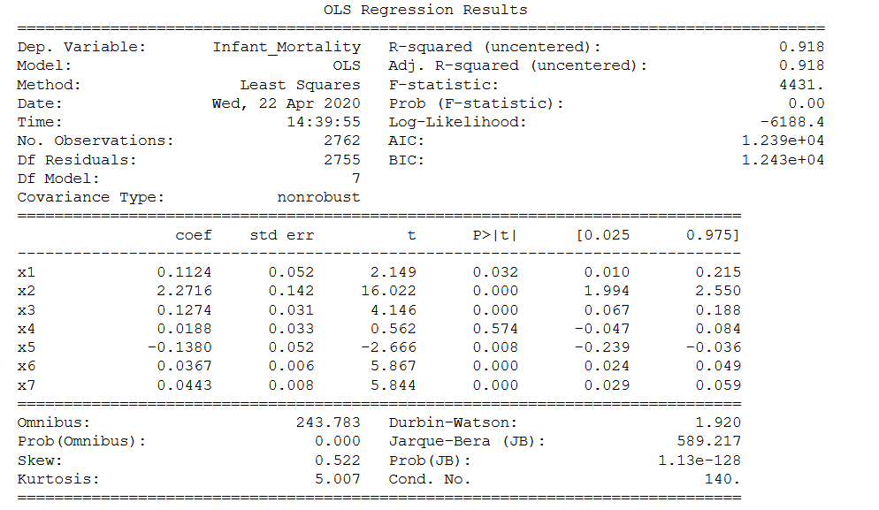
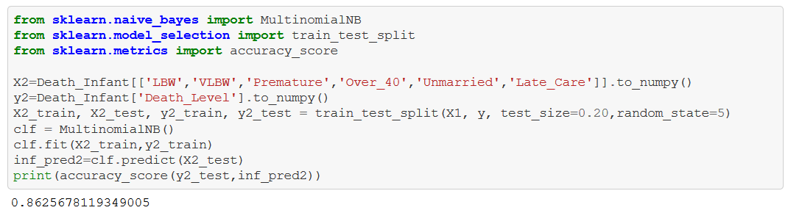
Backward Elimination & Accuracy
Focused Analysis : Illinois
In the world data, all factors satisfy the significance level except for pregnancies under 18. This makes sense, although it is unethical for an age of under 18, a lower age plays a role in producing a healthy offspring hence it does not affect the classifications. And there is lower bias in the model even though the accuracy is lower than the one with only Illinois data.

Slide 24
Predictive Modelling
Exploratory Data Analysis
Focused Analysis : Illinois
Modeling for Leading Causes of Death
Clustering of Counties
Problem Statement & Introduction
Leading Causes of Death

Slide 25
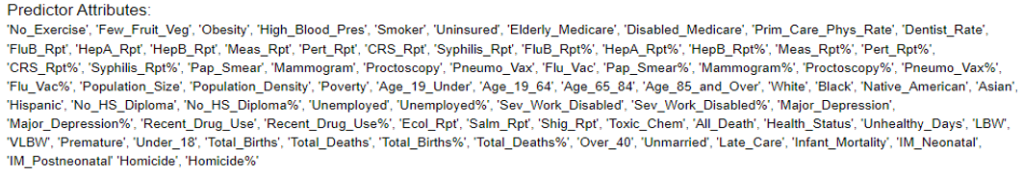
Modelling – 8 Random Forest Regressors
Modeling for Leading Causes of Death
Grid Search
4-Fold Cross Validation
Stroke
Colon Cancer
Input Features
Random Forest Models
Breast Cancer
Lung Cancer
Diabetes
Output
Average Life Expectancy
Suicide
Heart Disease

Slide 26
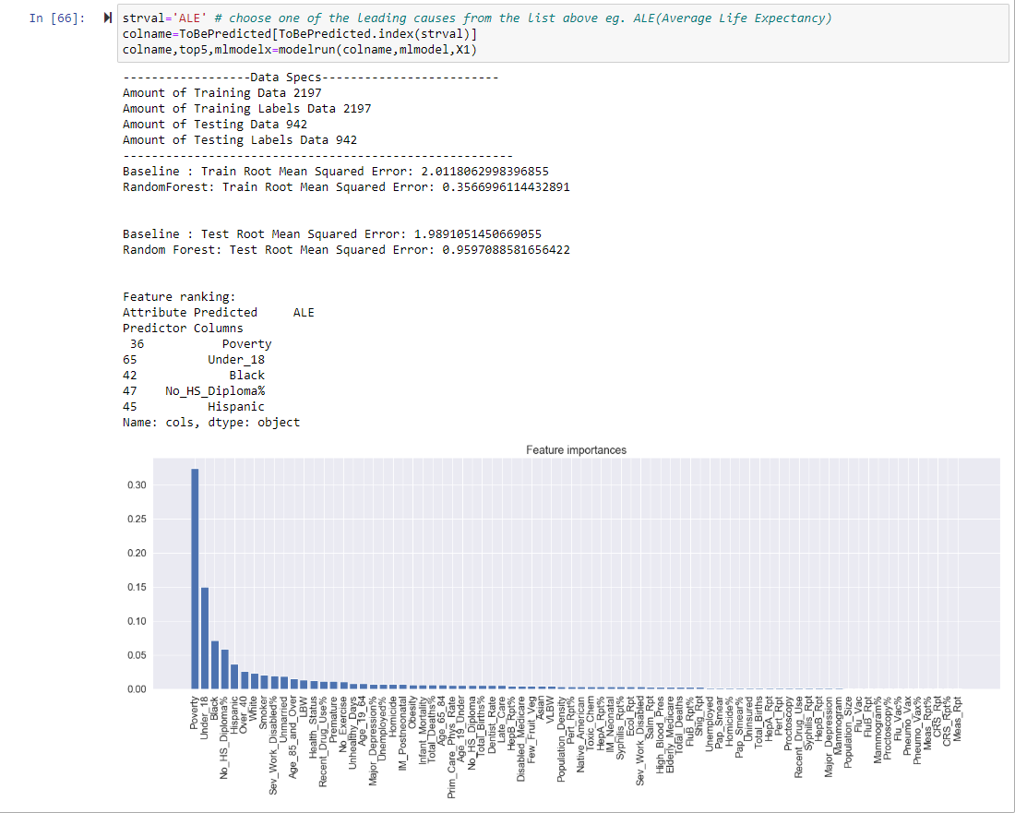
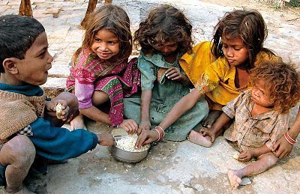

Prediction on Average Life Expectancy
Modeling for Leading Causes of Death
ALE
Poverty
Under_18
Black
No HS Diploma
Hispanic

Slide 27
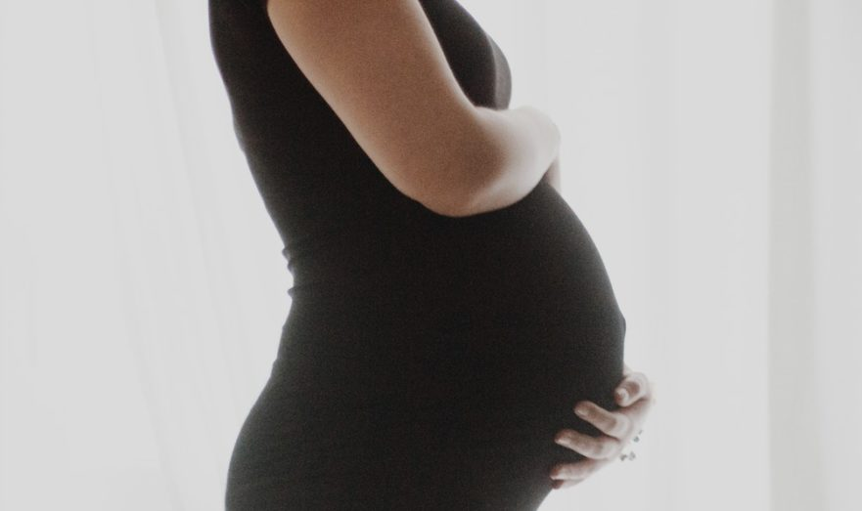
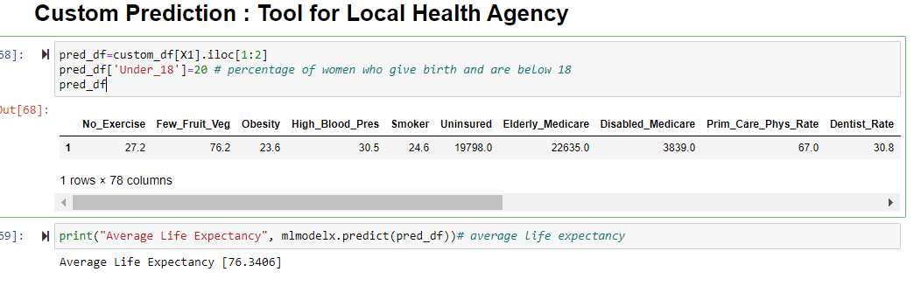
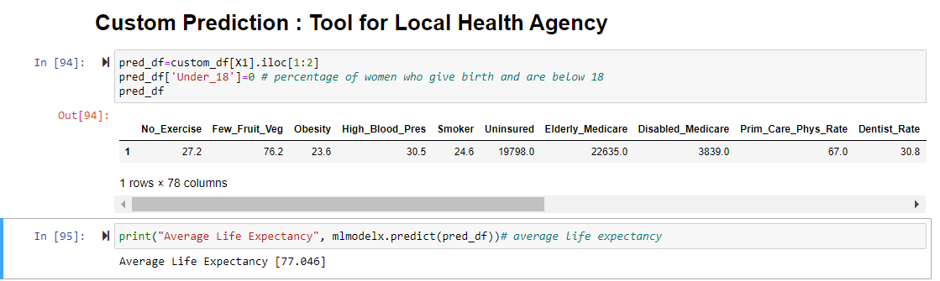
Predictive Tool
Modeling for Leading Causes of Death
Custom Values of Counties (Let’s tweak Under_18 Column)
Under_18
ALE
Under_18: % of women pregnancy who are under 18
*Can be done for all independent attributes like No exercise, Obesity etc.

Slide 28
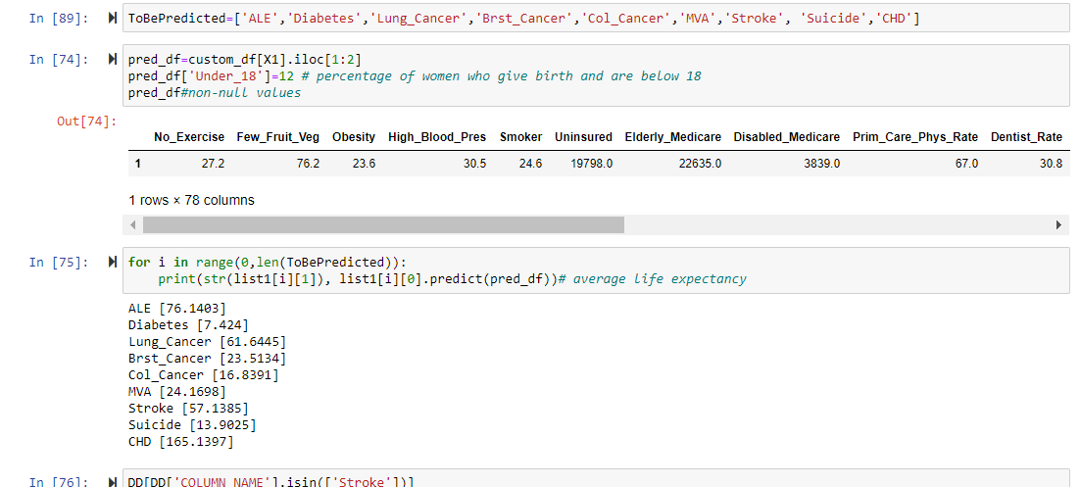
Modeling for Leading Causes of Death
Prediction for all 9 Models
Custom Values of Counties (Output of all models)

Slide 29
Clustering of Counties
Exploratory Data Analysis
Focused Analysis : Illinois
Modelling
Leading Causes of Death
Segmentation of Counties based on Leading Causes of Death
Problem Statement & Introduction
Leading Causes of Death

Slide 30
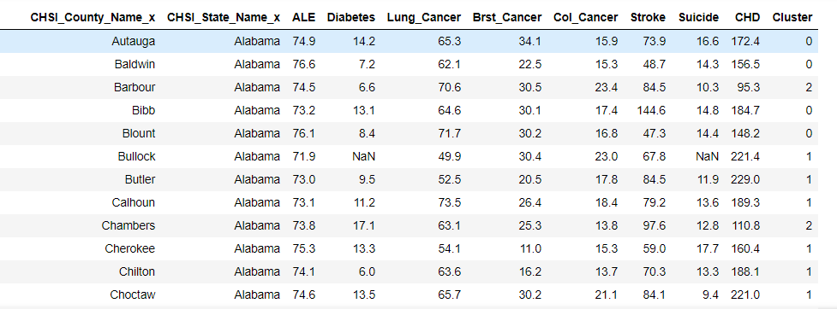
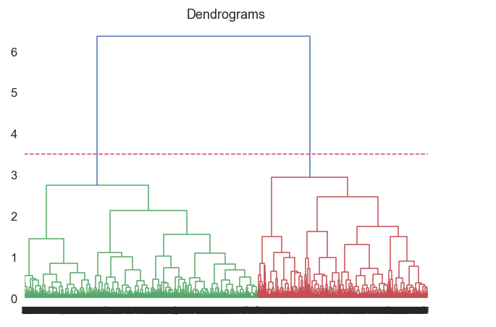
Clustering of Counties
Hierarchical Clustering on Counties
Every county belongs to a cluster.

Slide 31
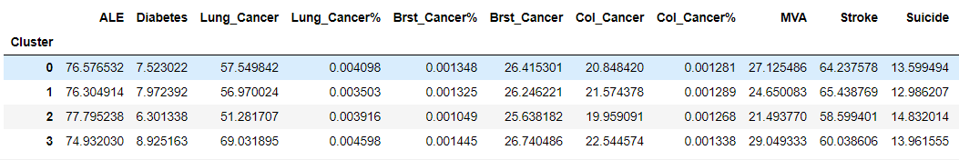

Clustering of Counties
Clustering
Counties which belong to Cluster 3 have lower Average Life Expectancy, higher levels for lung cancer, Diabetes and Breast Cancer Rate. (Local Health Agencies can focus more on them)

Slide 32

Clustering of Counties

Slide 33

Results
1. Machine Learning Models help us predict the values of leading causes of death of counties
Stroke
Colon Cancer
Breast Cancer
Lung Cancer
Diabetes
Average Life Expectancy
Suicide
Heart Disease
2. Segmentation of Counties of United States (4 Clusters) will assist the local health agencies to give more focus to particular counties which are at a higher risk.
Counties which belong to cluster 3

